Slide 1
Text to image using Generative Adversarial Network (GAN)
PRESENTED BY: SNEGAN V
REGISTER NO:211521104151
DEPARTMENT:COMPUTER SCIENCE AND ENGINEERING

Slide 2
PROJECT TITLE
Text To Image using GAN

Slide 3


AGENDA
Problem Statement
Project Overview
End Users
Our Solution and Proposition
Key Features
Modelling Approach
Results and Evaluation
Conclusion
3/21/2024 Annual Review

Slide 4

PROBLEM STATEMENT
Generating realistic images from textual descriptions is a challenging task in computer vision.
Existing methods often struggle to produce high-quality images that faithfully represent the input text.
There is a need for a robust and efficient system that can accurately translate textual descriptions into realistic images.

Slide 5
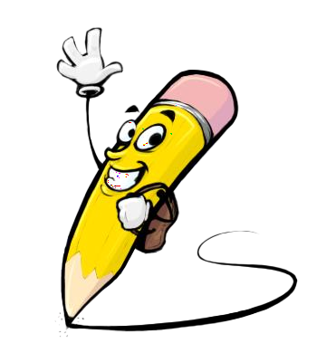
PROJECT OVERVIEW
Our project aims to address this challenge by leveraging the power of Generative Adversarial Networks (GANs).
GANs have shown promising results in generating high-fidelity images and are well-suited for text-to-image synthesis tasks.
By harnessing the power of deep learning and natural language processing, our system aims to revolutionize the way visual content is created and consumed, offering new possibilities for creativity and expression in various fields such as design, storytelling, and education.

Slide 6

WHO ARE THE END USERS?
Our solution is targeted towards a wide range of end users, including graphic designers, artists, and content creators.
These users can benefit from an automated tool that can quickly generate visual content based on textual descriptions, saving time and effort in the creative process.

Slide 7

OUR SOLUTION AND ITS VALUE PROPOSITION
Our solution is a novel approach that combines advanced deep learning techniques with state-of-the-art GAN architectures to generate high-quality images from textual descriptions.
The key proposition of our system lies in its ability to generate diverse and realistic images that closely match the input text, offering a valuable tool for artists, designers, and creators to visualize their ideas quickly and effectively.
Furthermore, our system is designed to be scalable and adaptable, allowing for future enhancements and integration into various applications and platforms.

Slide 8

THE "WOW" IN OUR SOLUTION
Text-to-image generation: Ability to convert textual descriptions into high-quality images.
Realistic image output: Generated images closely resemble the scenes described in the input text.
Support for various input text descriptions: The system can handle a wide range of textual inputs, allowing for diverse image generation.
3/21/2024 Annual Review
8

Slide 9
MODELLING
Dataset collection and preprocessing: We collected a dataset of paired text and images from various sources.
GAN model architecture selection: We chose a GAN architecture suitable for text-to-image synthesis, such as DCGAN or StackGAN.
Training process and hyperparameter tuning: We trained the GAN model using the collected dataset, optimizing the hyperparameters for best performance.
9

Slide 10
Training process and hyperparameter tuning: We trained our model using the collected dataset and fine-tuned the hyperparameters to optimize performance. We used a batch size of 64, a learning rate of 0.0002, and trained the model for 100,000 iterations. We also used techniques such as gradient clipping and spectral normalization to stabilize training.
Data augmentation: To further improve the robustness of our model, we applied data augmentation techniques such as random cropping, rotation, and flipping to the input images during training. This helped the model generalize better to unseen data and produce more diverse output.

Slide 11
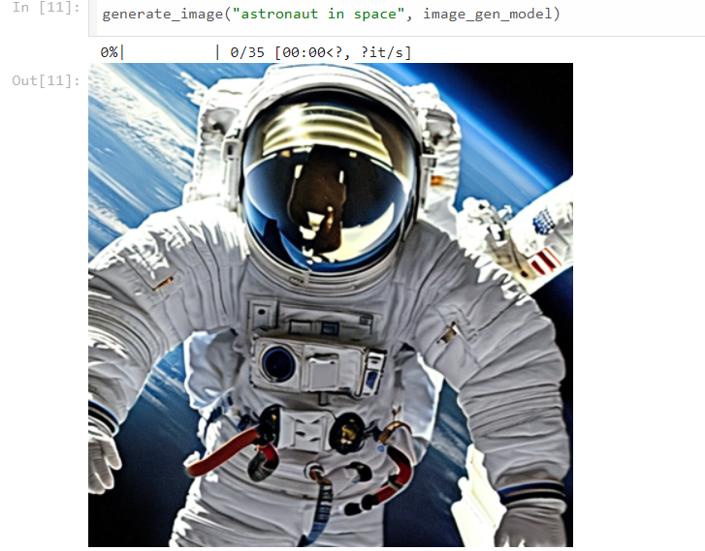
RESULT
11

Slide 12
Evaluation:
Qualitative evaluation: We visually compared the generated images with ground truth images to assess their realism and fidelity to the input text.
Quantitative evaluation: We used metrics such as Inception Score (IS) and Frechet Inception Distance (FID) to quantitatively evaluate the quality of the generated images.

Slide 13
conclusion
Our project demonstrates the effectiveness of using GANs for text-to-image synthesis, achieving realistic image generation from textual descriptions.
Future work could focus on improving the diversity and creativity of the generated images, as well as exploring applications in areas such as virtual reality and gaming.

